Slide 1


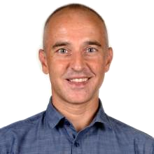
Lecture 6b
Attention Mechanisms
Master in Big Data Solutions 2020-2021 - Artificial Intelligence
Xavier Giró
xavier.giro@bts.tech

Slide 2
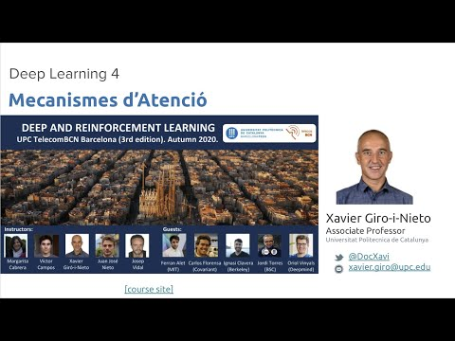
Similar lecture (in Catalan)

Slide 3
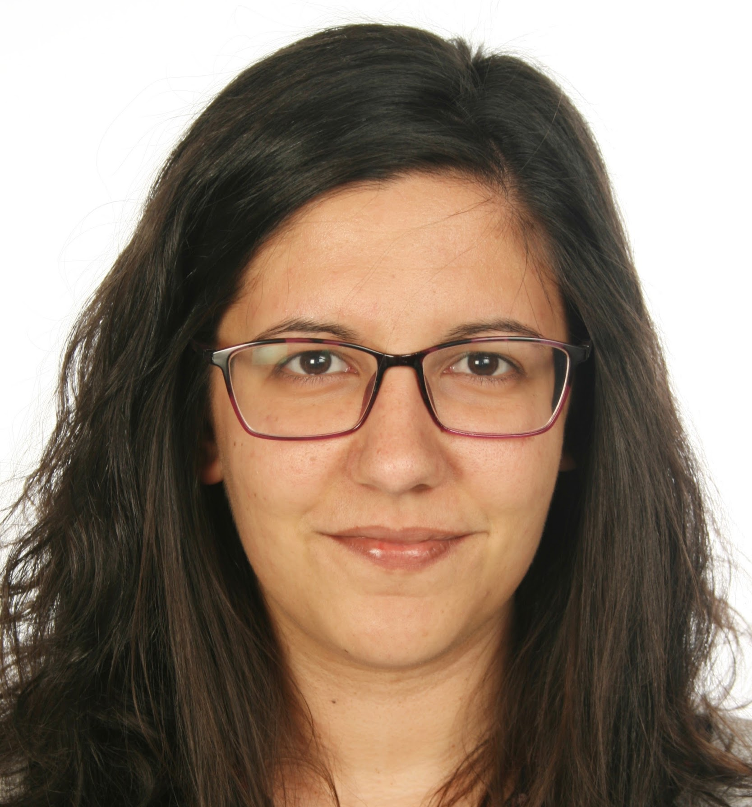
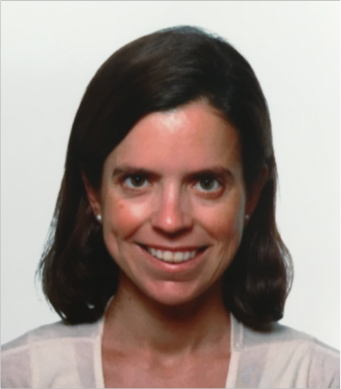
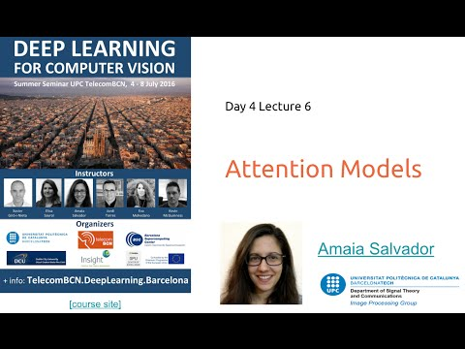
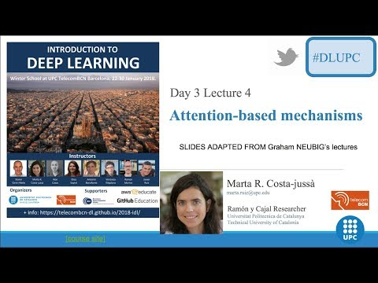
Acknowledgments
Amaia Salvador
Marta R. Costa-jussà
PhD (2019)
Universitat Politècnica de Catalunya
Associate Professor
Universitat Politècnica de Catalunya
[DLCV 2016]
[IDL 2018]

Slide 4

Outline
Motivation
Seq2Seq
Key, Query and Value
Seq2Seq + Attention
Attention mechanisms
Study case: Image captioning

Slide 5
Outline
Motivation
Seq2Seq
Key, Query and Value
Seq2Seq + Attention
Attention mechanisms
Study case: Image captioning

Slide 6
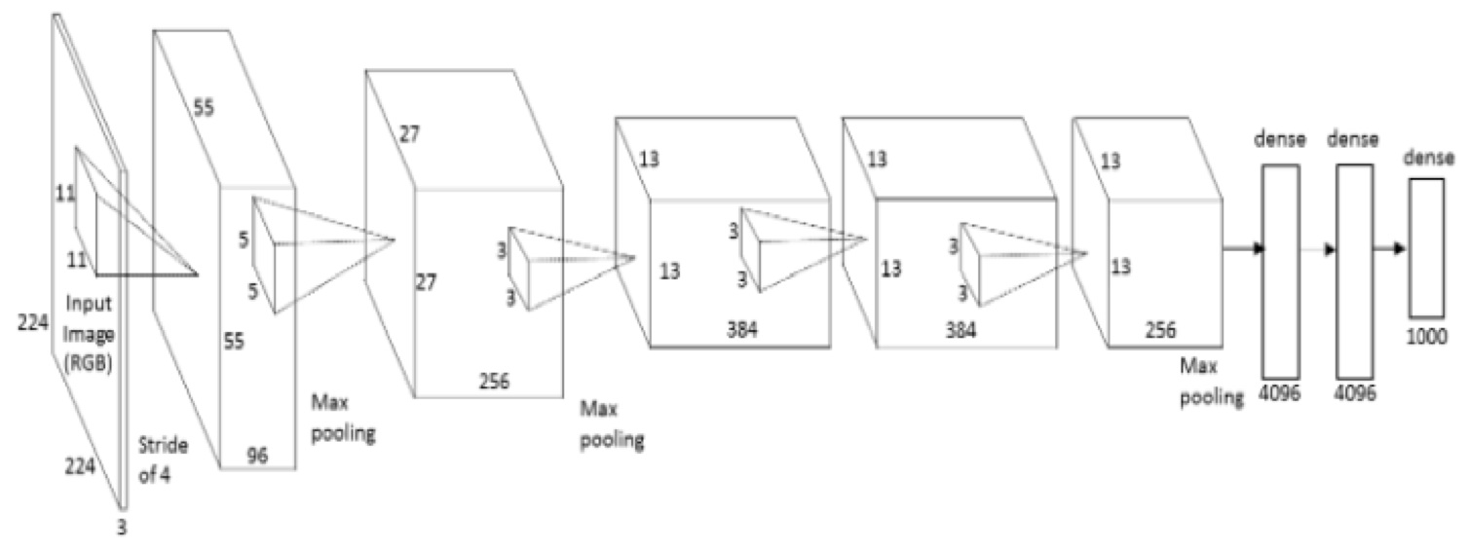

Motivation: Vision
The whole input volume is used to predict the output...
bird
Image: H x W x 3

Slide 7
Motivation: Vision
The whole input volume is used to predict the output...
bird
Image: H x W x 3
...despite the fact that not all pixels are equally important

Slide 8
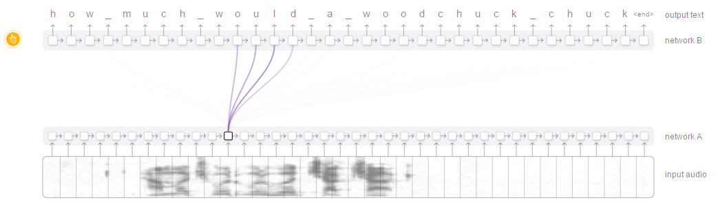
Motivation: Automatic Speech Recognition (ASR)
Transcribed letters correspond with just a few phonemes.
Figure: distill.pub
Chan, W., Jaitly, N., Le, Q., & Vinyals, O. Listen, attend and spell: A neural network for large vocabulary conversational speech recognition. ICASSP 2016.

Slide 9

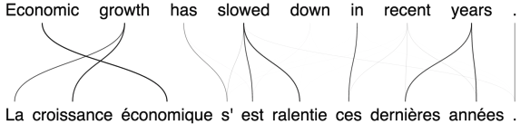

Motivation: Neural Machine Translation (NMT)
The translated words are often related to a subset of the words from the source sentence.
(Edge thicknesses represent the attention weights found by the attention model)
Kyunghyun Cho, “Introduction to Neural Machine Translation with GPUs” (2015)

Slide 10
Outline
Motivation
Seq2Seq
Key, Query and Value
Seq2Seq + Attention
Attention mechanisms
Study case: Image captioning

Slide 11
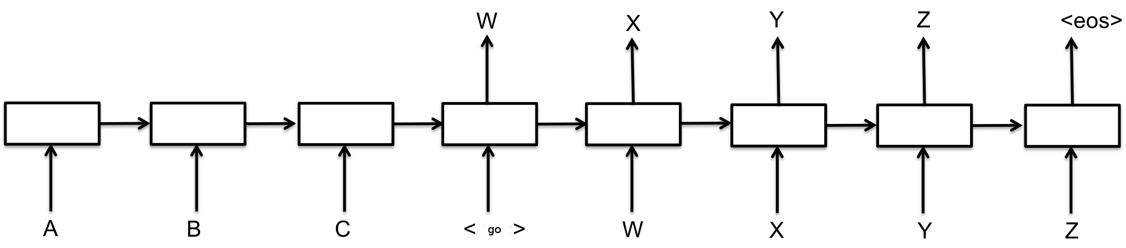
Seq2Seq with RNN
The Seq2Seq scheme can be implemented with RNNs:
trigger the output generation with an input <go> symbol.
the predicted word at timestep t, becomes the input at t+1.
Sutskever, Ilya, Oriol Vinyals, and Quoc V. Le. "Sequence to sequence learning with neural networks." NIPS 2014.

Slide 12
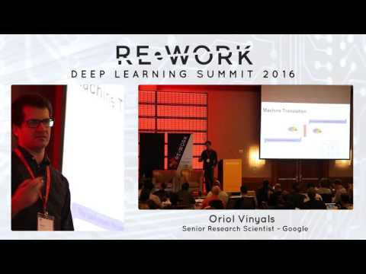
Seq2Seq with RNN
Sutskever, Ilya, Oriol Vinyals, and Quoc V. Le. "Sequence to sequence learning with neural networks." NIPS 2014.

Slide 13
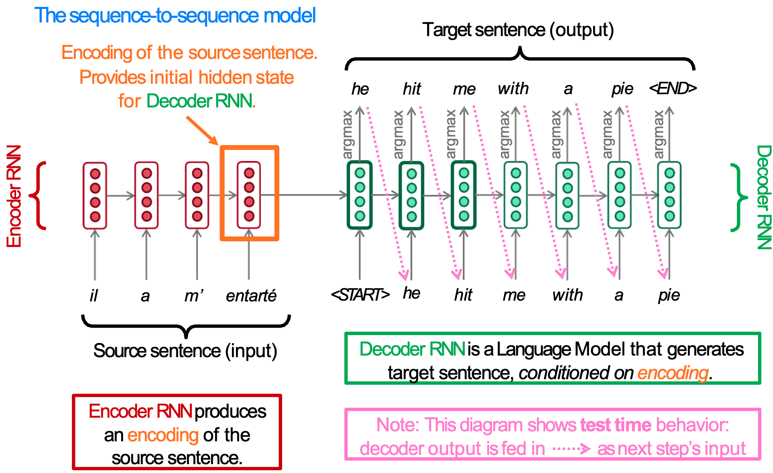
Seq2Seq for NMT
Slide: Abigail See, Matthew Lamm (Stanford CS224N), 2020

Slide 14
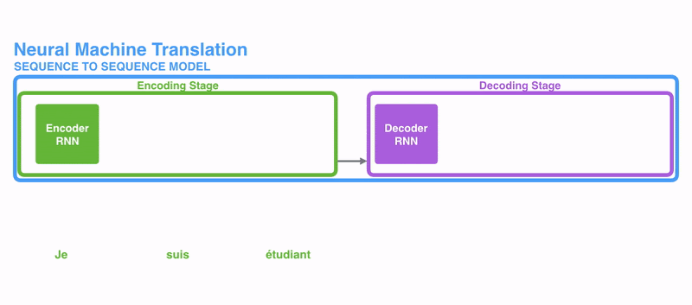
Seq2Seq for NMT
Figure: Jay Alammar, “Visualizing A Neural Machine Translation Model”

Slide 15
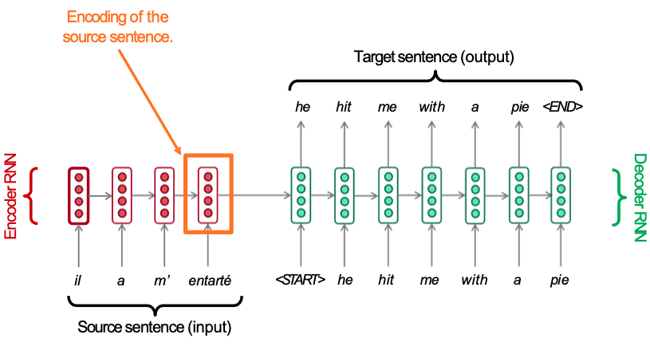
Seq2Seq for NMT
How does the length of the source sentence affect the size (d) of its encoding ?
Slide concept: Abigail See, Matthew Lamm (Stanford CS224N), 2020

Slide 16
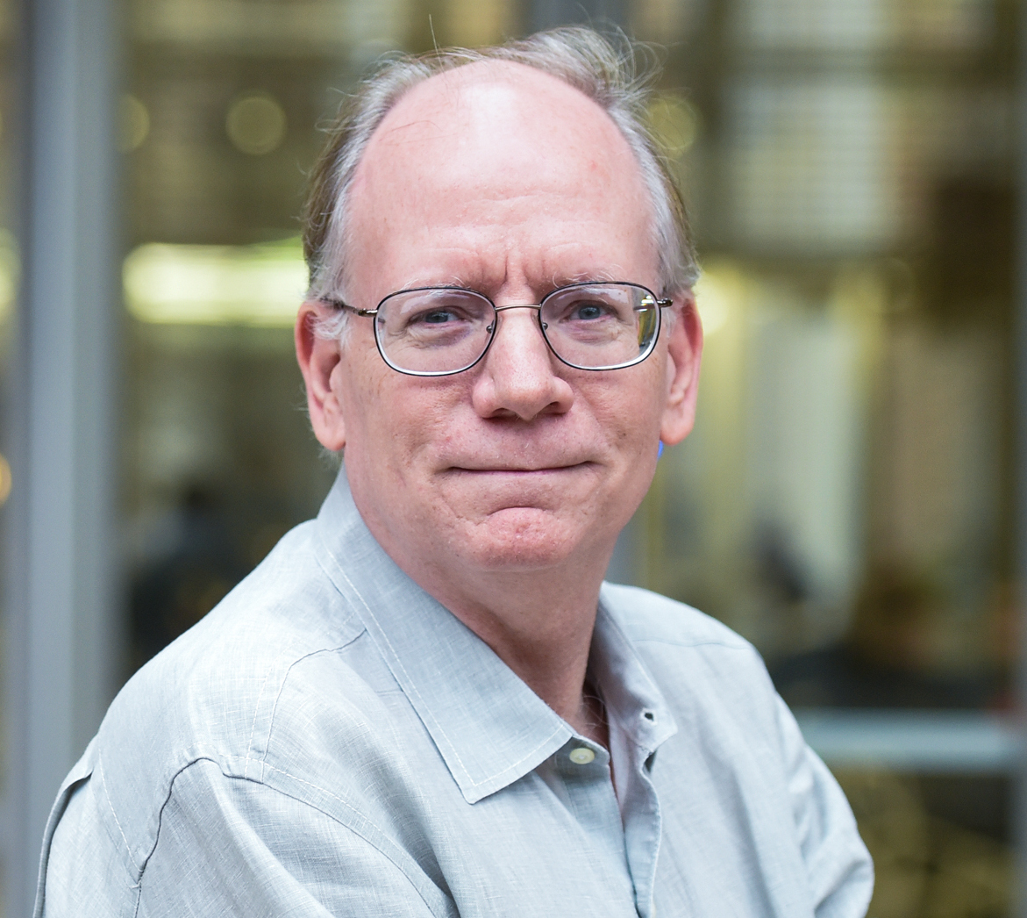
Seq2Seq for NMT
How does the length of the input sentence affect the size (d) of its encoded representation ?
"You can't cram the meaning of a whole %&!$# sentence into a single $&!#* vector!"
Ray Mooney, ACL 2014 Workshop on Semantic Parsing.

Slide 17
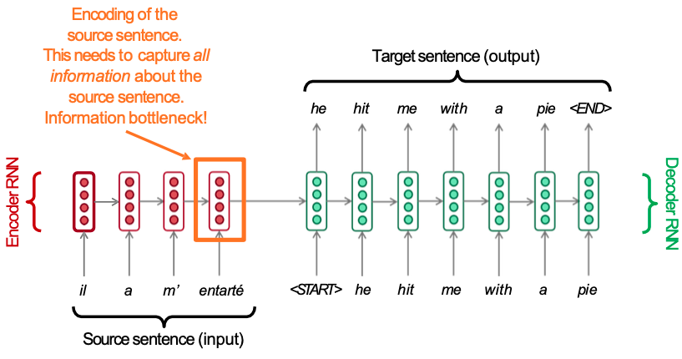
Seq2Seq for NMT: Information bottleneck
Slide concept: Abigail See, Matthew Lamm (Stanford CS224N), 2020

Slide 18
Outline
Motivation
Seq2Seq
Key, Query and Value
Seq2Seq + Attention
Attention mechanisms
Study case: Image captioning

Slide 19
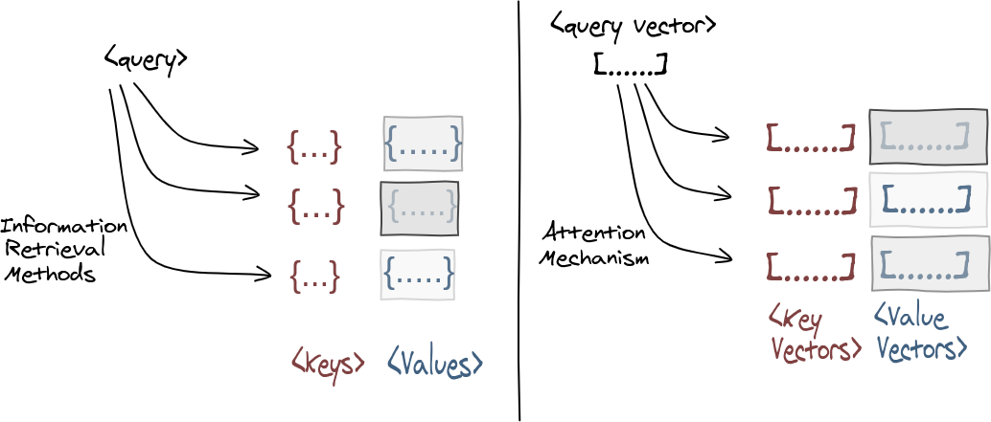

Query, Keys & Values
Databases store information as pair of keys and values (K,V).
Example:
myfile.pdf
<Key> <Value>
Figure: Nikhil Shah, “Attention? An Other Perspective! [Part 1]” (2020)

Slide 20
Query, Keys & Values
The (K,Q,V) terminology used to retrieve information from databases is adopted to formulate attention.
Figure: Nikhil Shah, “Attention? An Other Perspective! [Part 1]” (2020)

Slide 21
Query, Keys & Values
Attention is a mechanism to compute a context vector (c) for a query (Q) as a weighted sum of values (V).
Figure: Nikhil Shah, “Attention? An Other Perspective! [Part 1]” (2020)

Slide 22
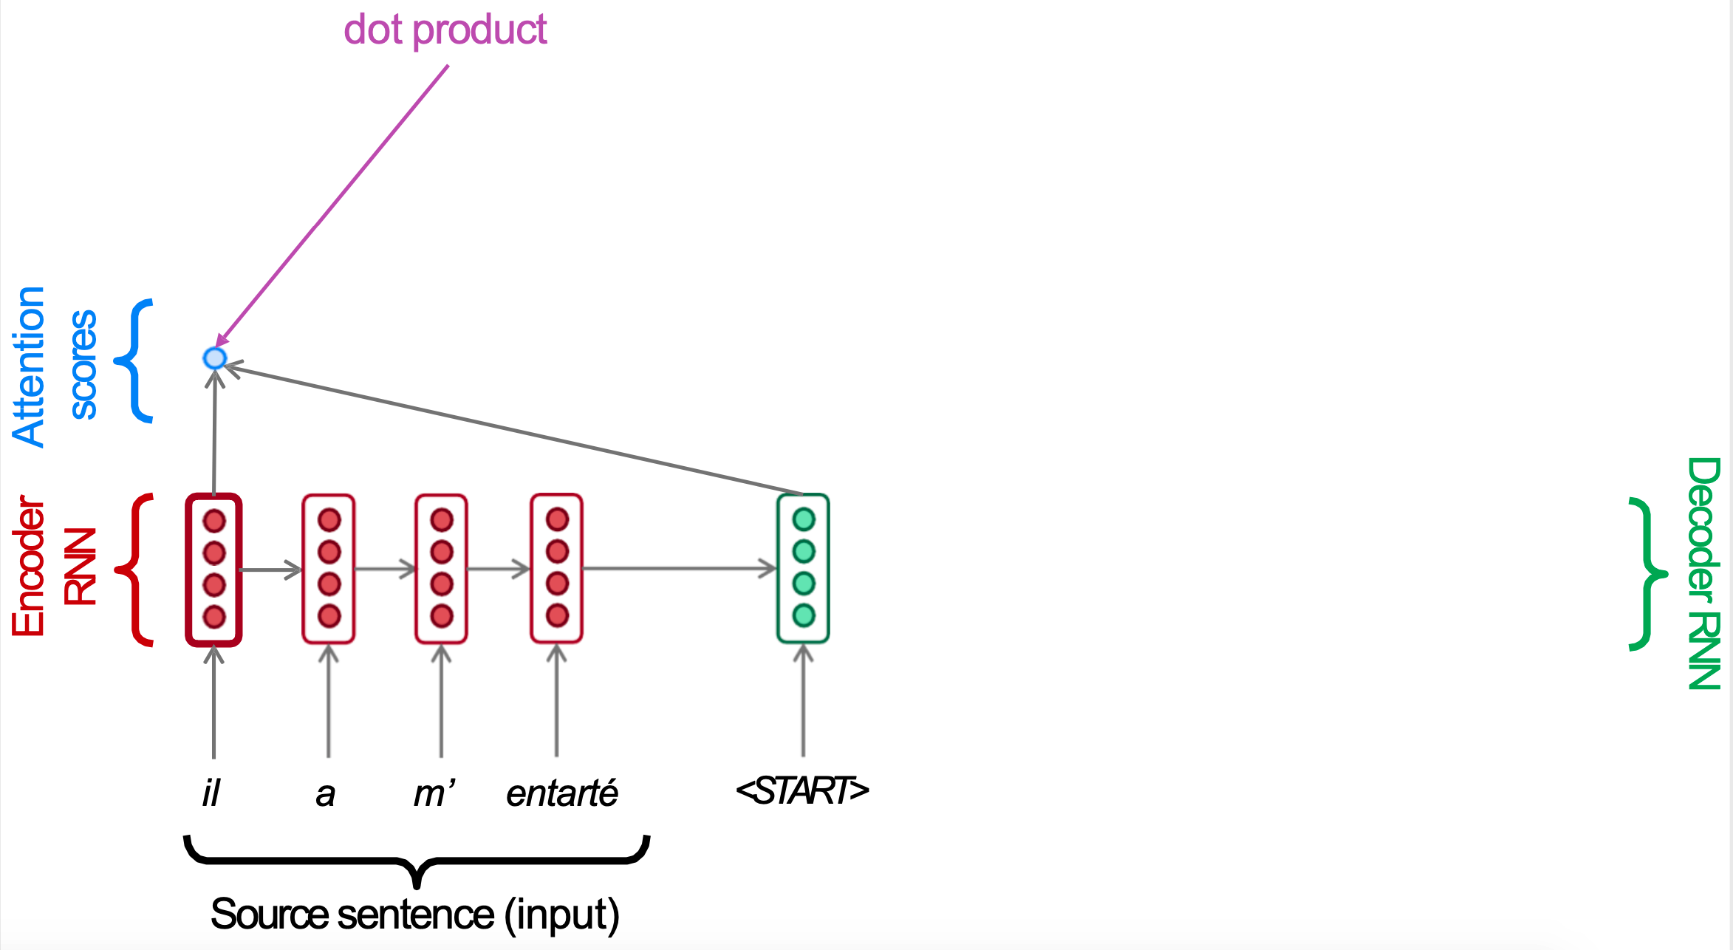
Query, Keys & Values
Usually, both keys and values correspond to the encoder states.
Key (K) / Values (V)
Query (Q)
Slide concept: Abigail See, Matthew Lamm (Stanford CS224N), 2020

Slide 23
Outline
Motivation
Seq2Seq
Key, Query and Value
Seq2Seq + Attention
Attention mechanisms
Study case: Image captioning

Slide 24
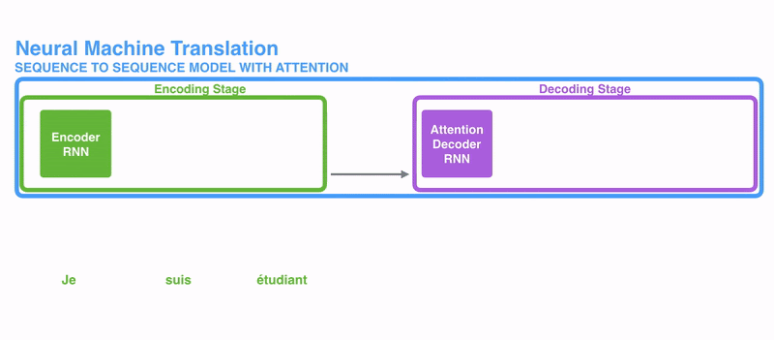
Seq2Seq + Attention
Figure: Jay Alammar, “Visualizing A Neural Machine Translation Model” (2018)

Slide 25
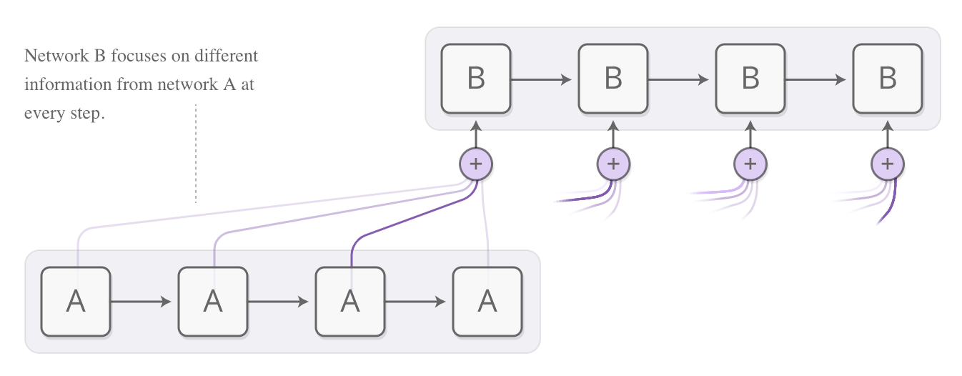
Seq2Seq + Attention
Chis Olah & Shan Cate, “Attention and Augmented Recurrent Neural Networks” distill.pub 2016.

Slide 26
Seq2Seq + Attention: NMT
Slide concept: Abigail See, Matthew Lamm (Stanford CS224N), 2020

Slide 27
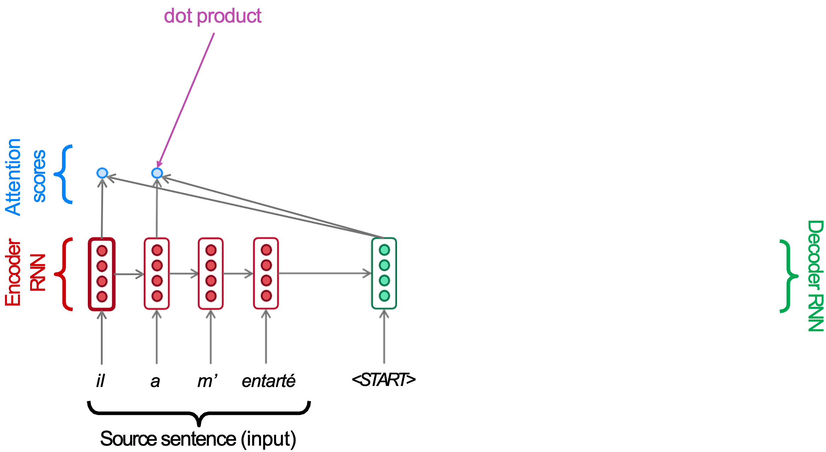
Seq2Seq + Attention: NMT
Slide concept: Abigail See, Matthew Lamm (Stanford CS224N), 2020

Slide 28

Seq2Seq + Attention: NMT
Slide concept: Abigail See, Matthew Lamm (Stanford CS224N), 2020

Slide 29

Seq2Seq + Attention: NMT
Slide concept: Abigail See, Matthew Lamm (Stanford CS224N), 2020

Slide 30
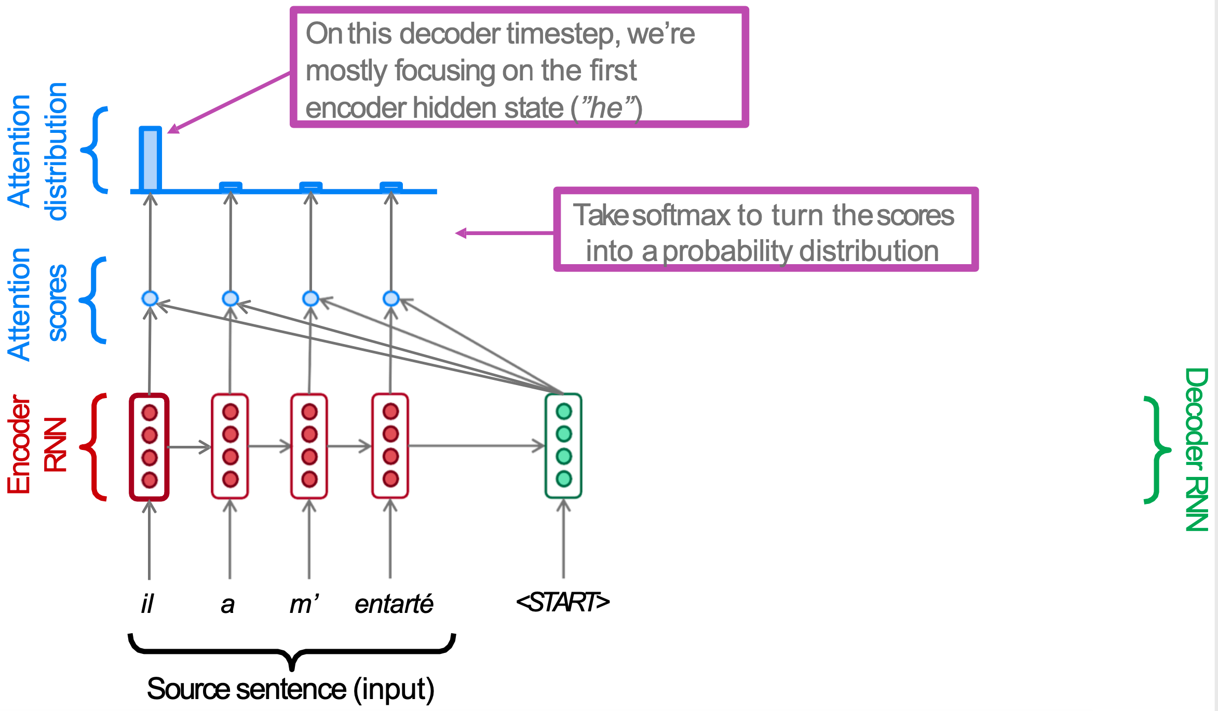
Seq2Seq + Attention: NMT
Softmax
Slide concept: Abigail See, Matthew Lamm (Stanford CS224N), 2020

Slide 31
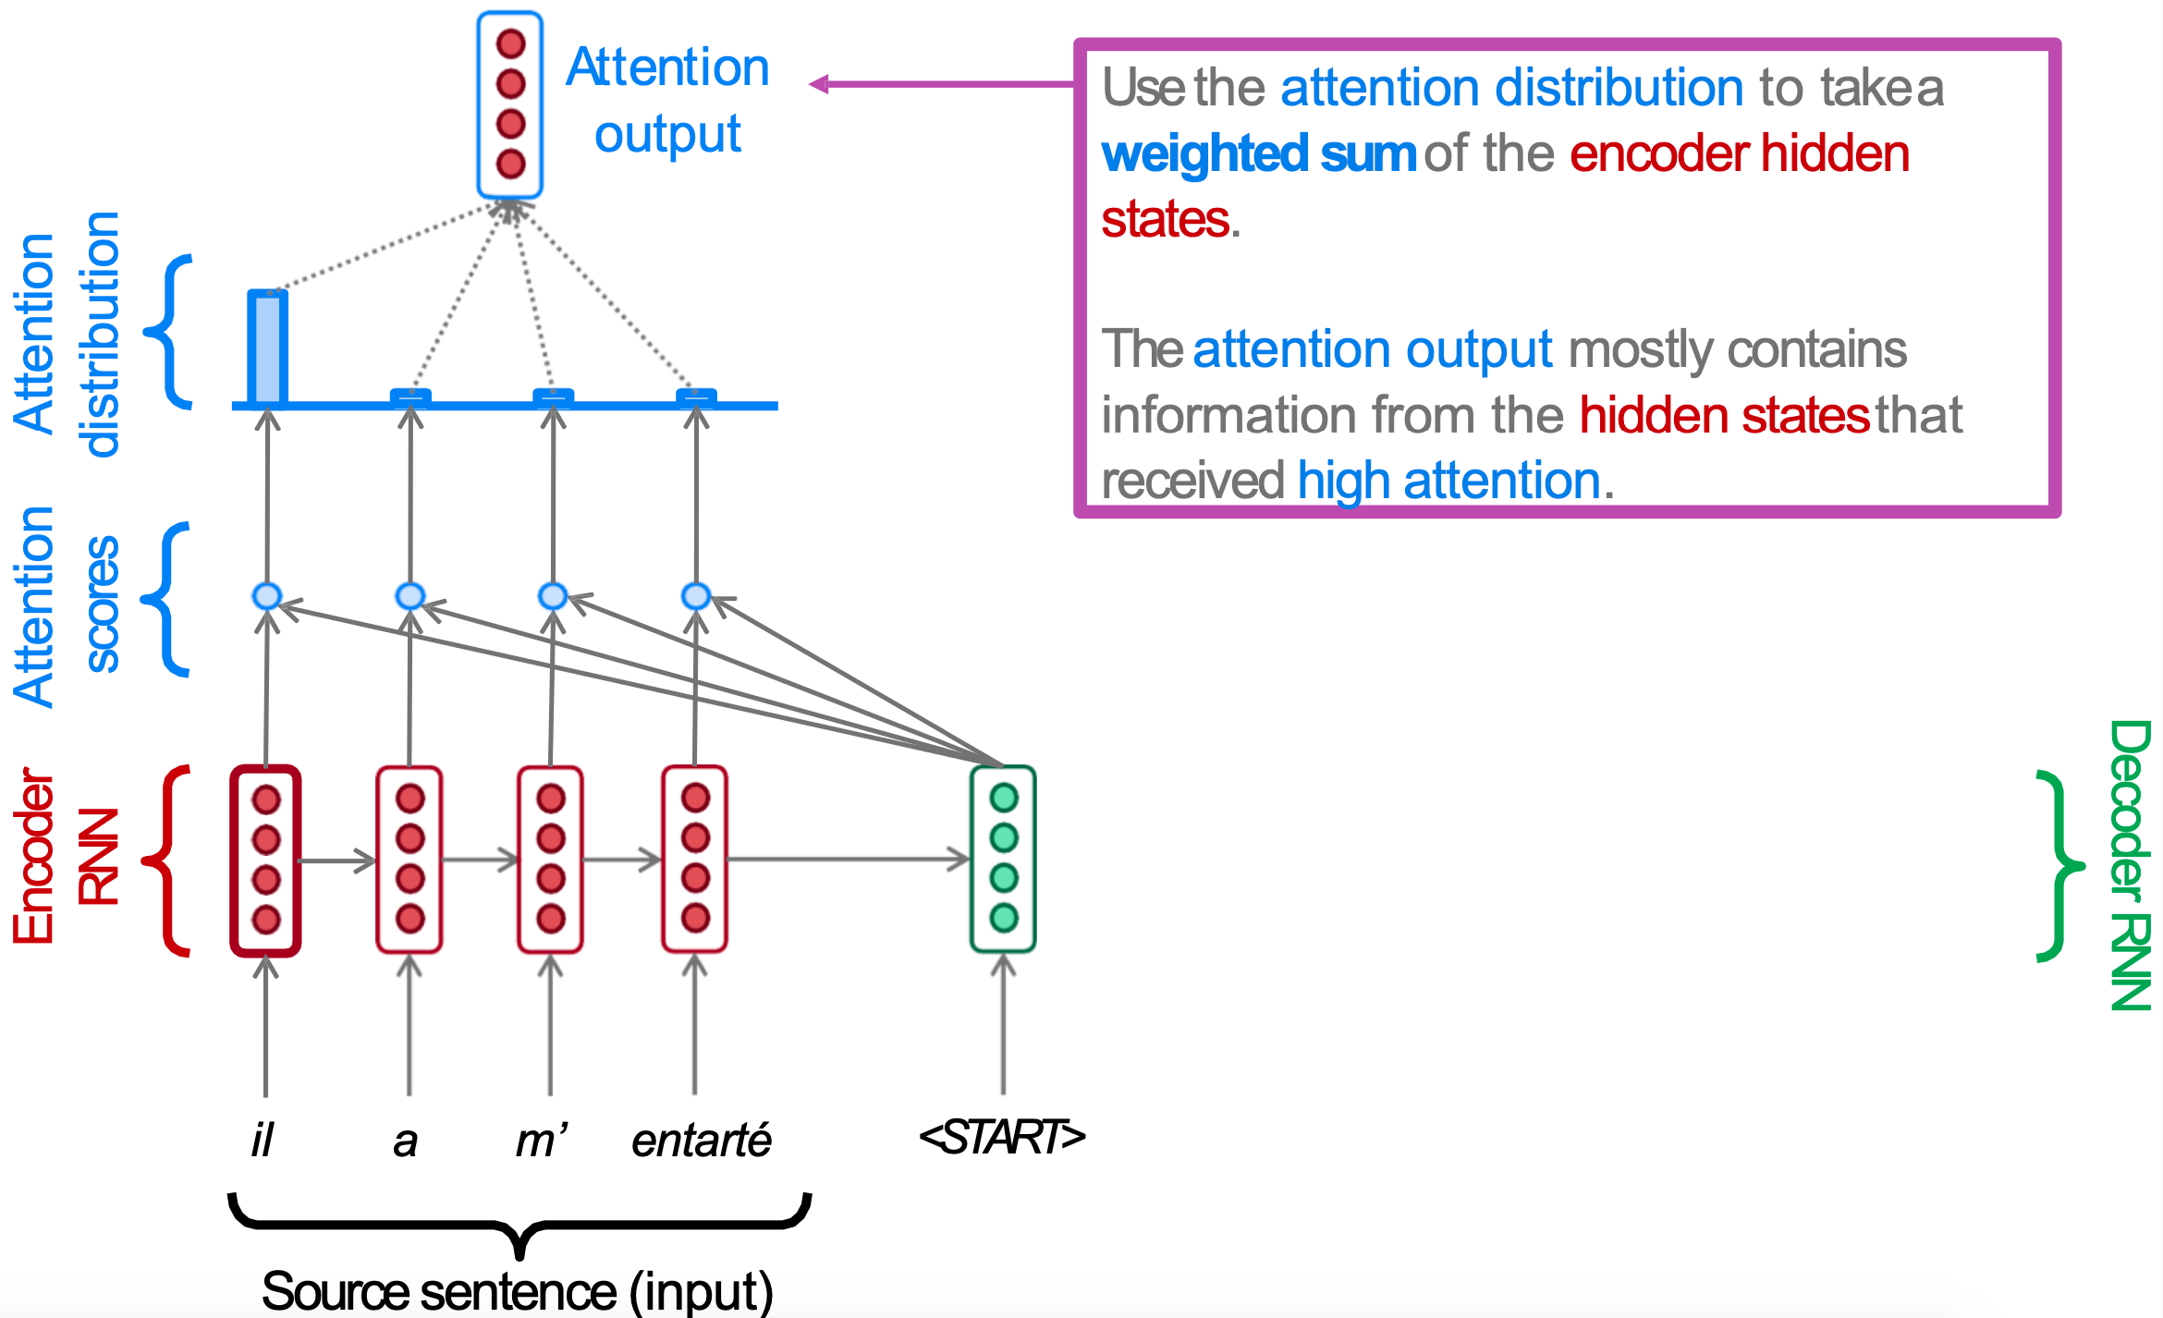
Seq2Seq + Attention: NMT
Slide concept: Abigail See, Matthew Lamm (Stanford CS224N), 2020

Slide 32
Seq2Seq + Attention: NMT
Context (c)
Slide concept: Abigail See, Matthew Lamm (Stanford CS224N), 2020

Slide 33
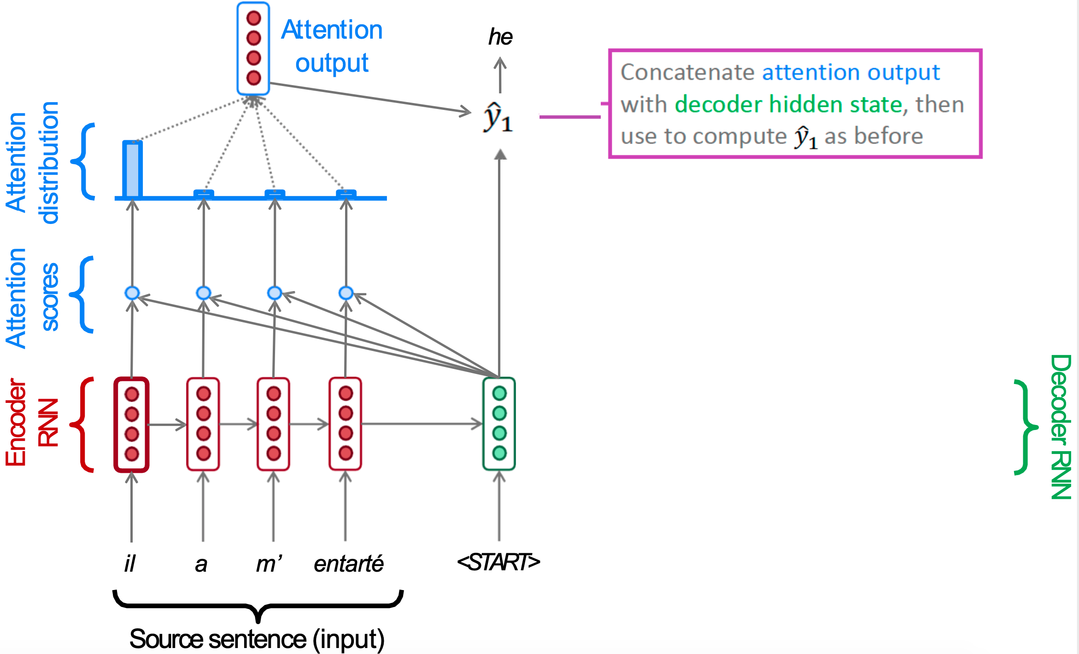
Seq2Seq + Attention: NMT
Slide concept: Abigail See, Matthew Lamm (Stanford CS224N), 2020

Slide 34
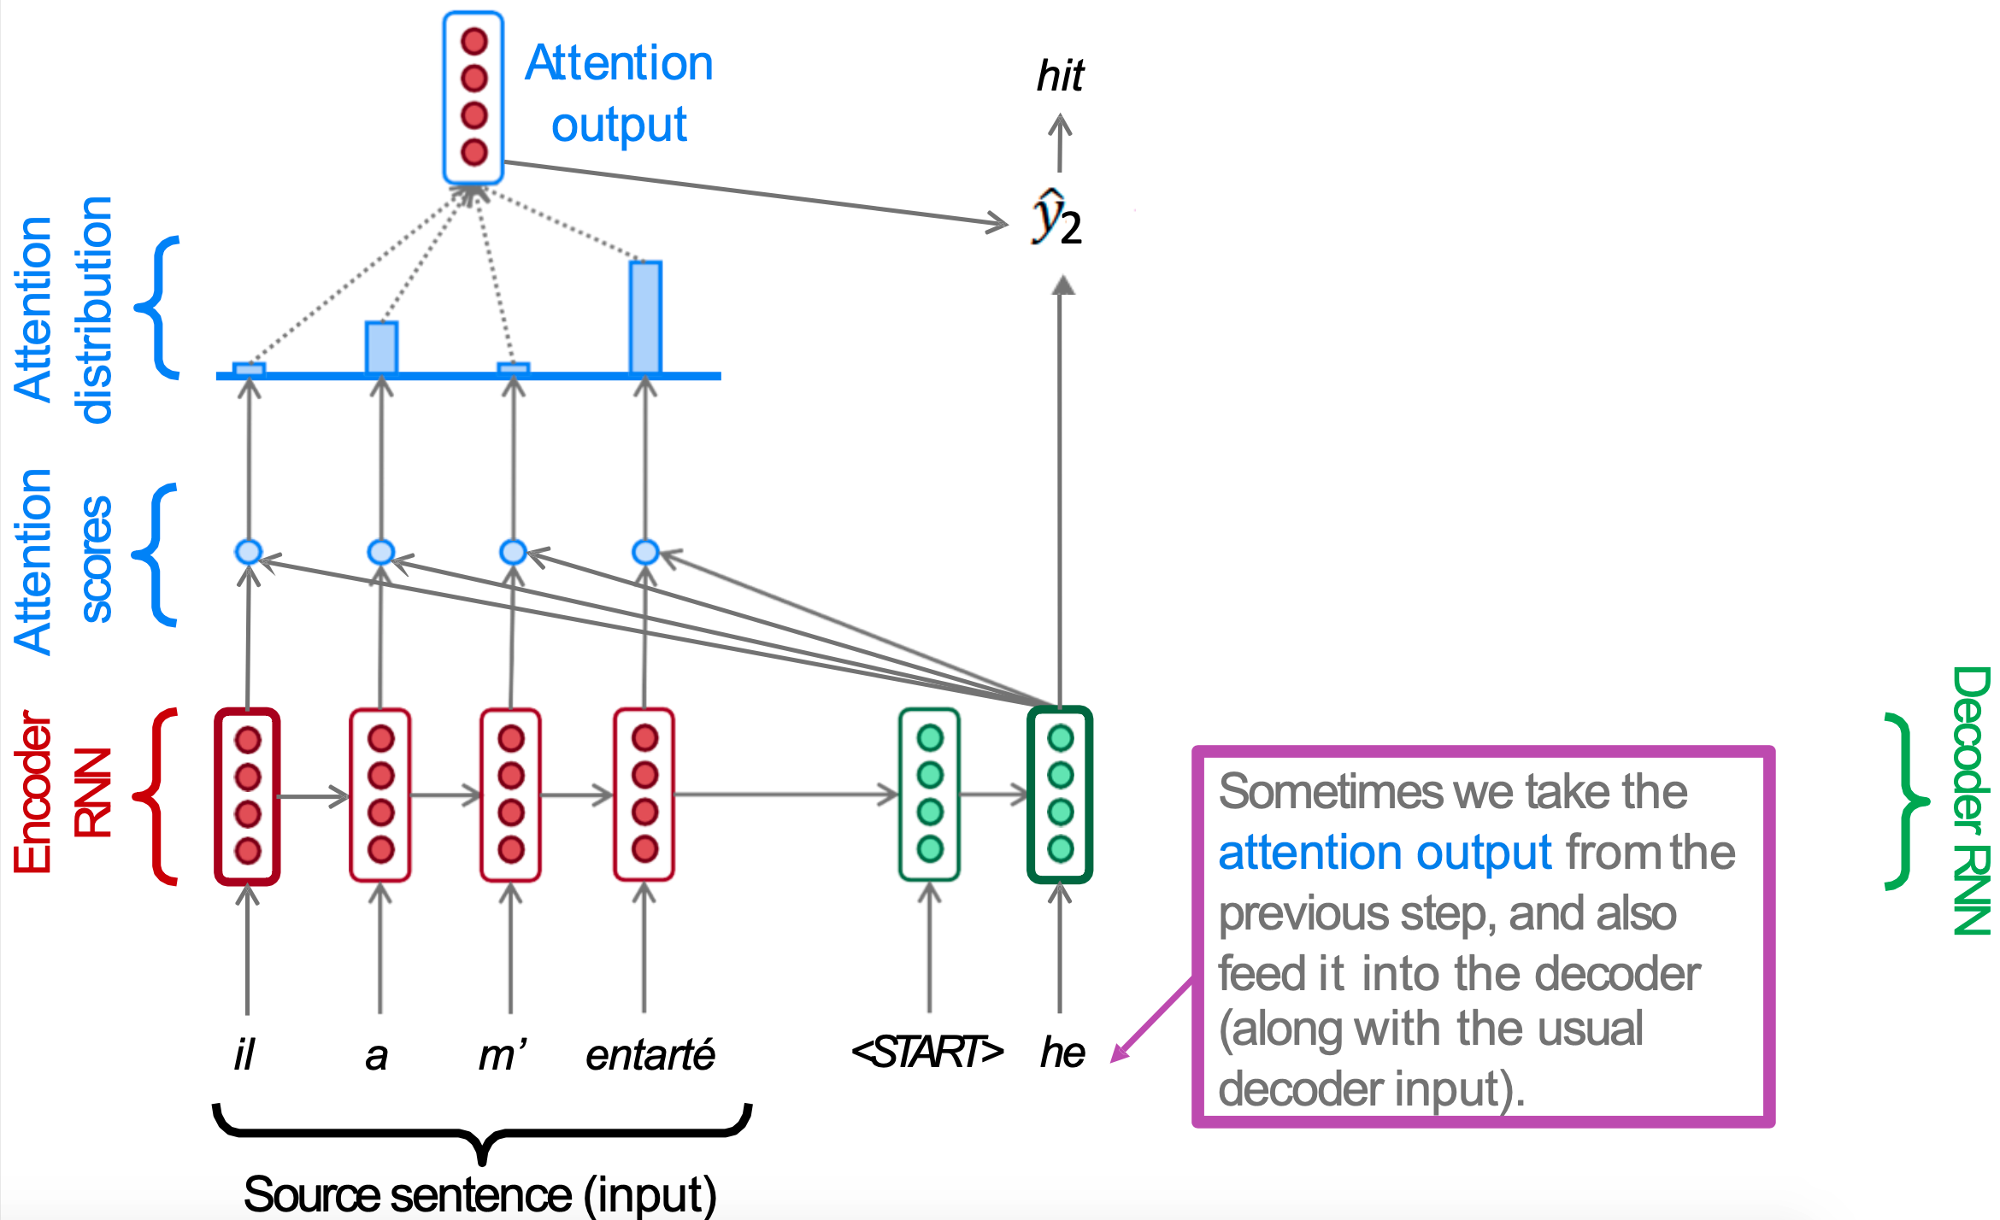
Seq2Seq + Attention: NMT
Slide: Marta R. Costa-jussà

Slide 35
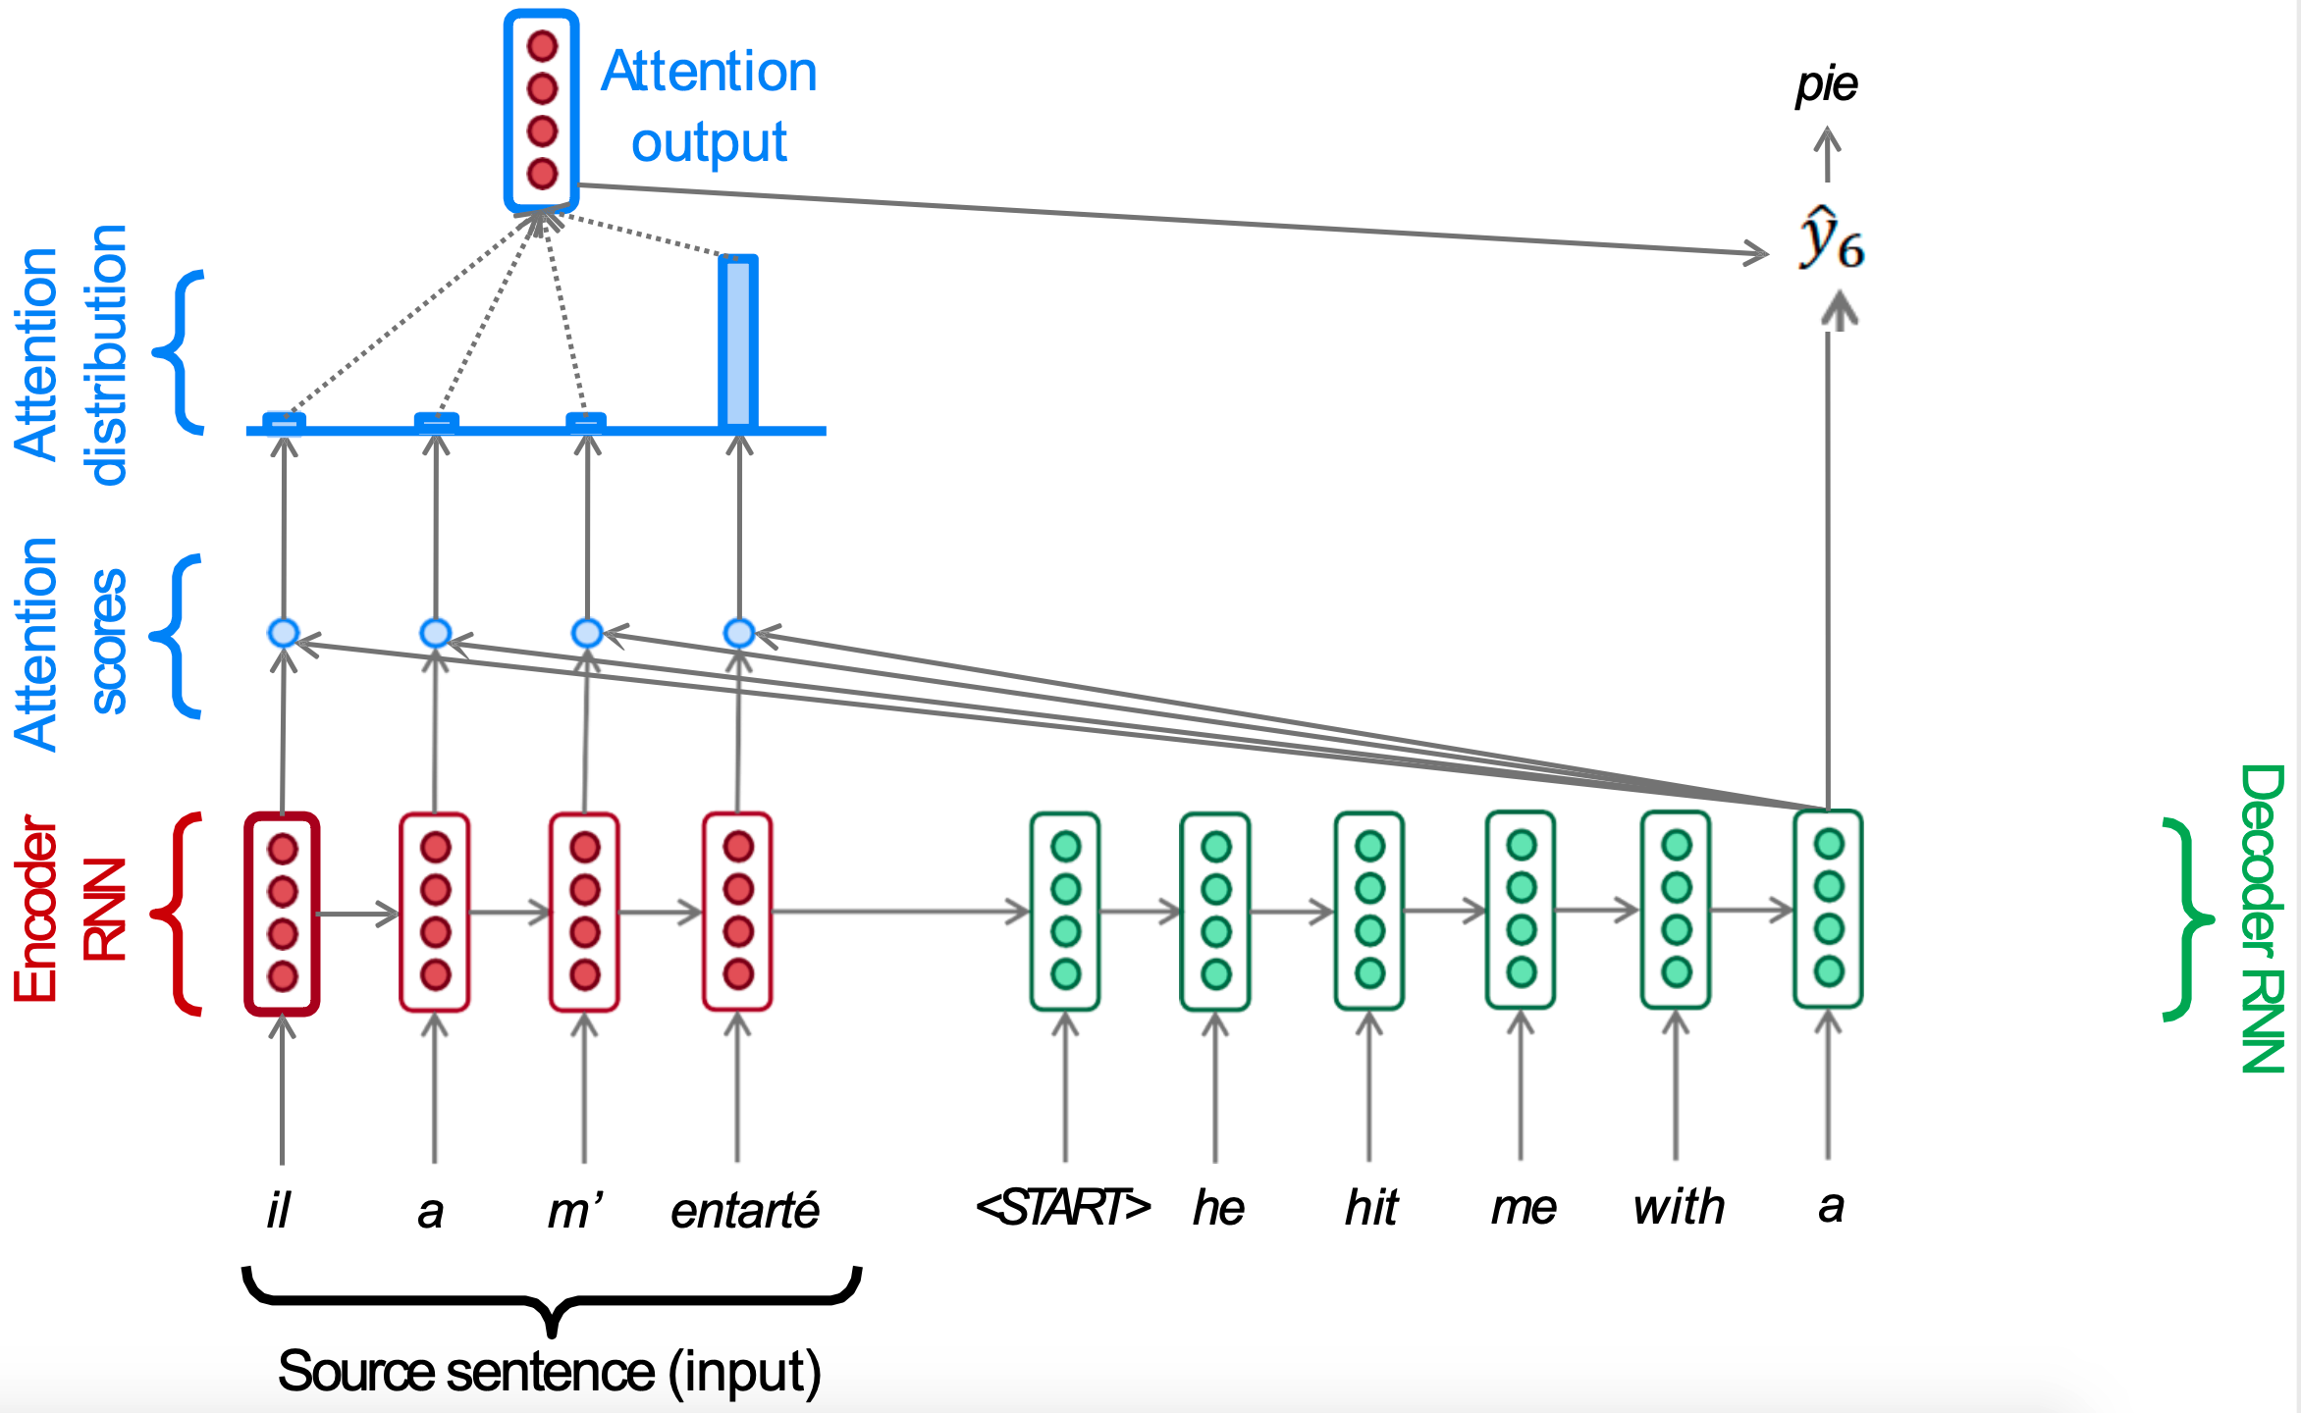
Seq2Seq + Attention: NMT
Slide concept: Abigail See, Matthew Lamm (Stanford CS224N), 2020

Slide 36
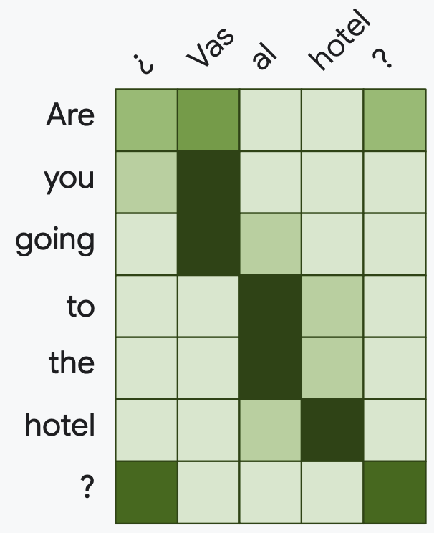
Attention matrix
Figure: Ilharco, Ilharco, Turc, Dettmers, Ferreira, Lee, “High Performance Natural Language Processing”. EMNLP 2020.

Slide 37
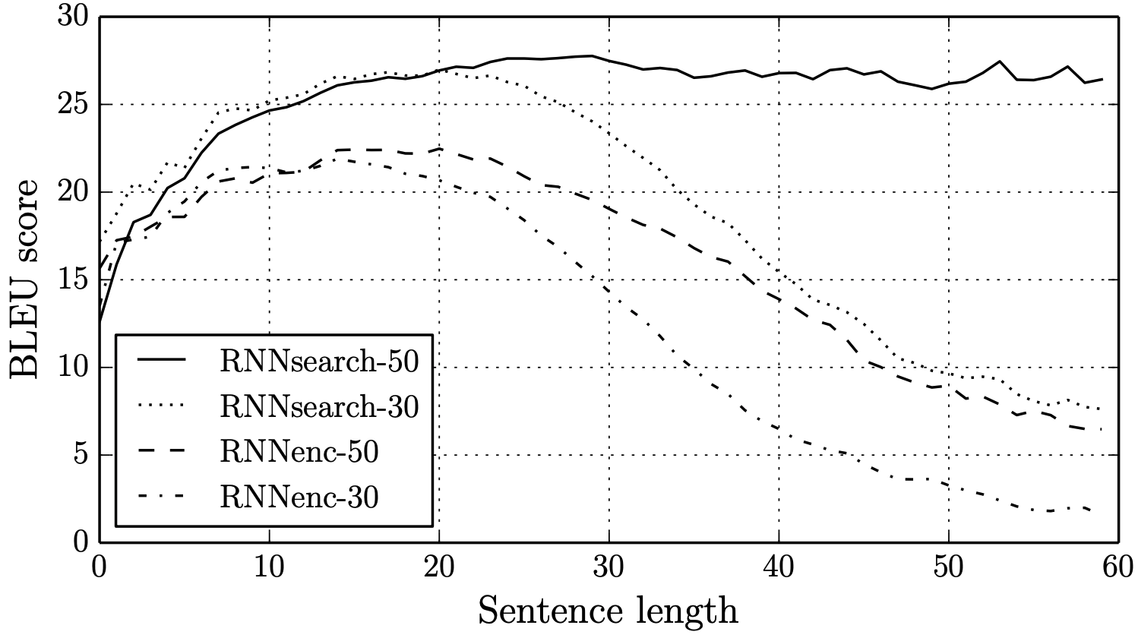
Seq2Seq + Attention: NMT
Bahdanau, Dzmitry, Kyunghyun Cho, and Yoshua Bengio. "Neural machine translation by jointly learning to align and translate." ICLR 2015.

Slide 38
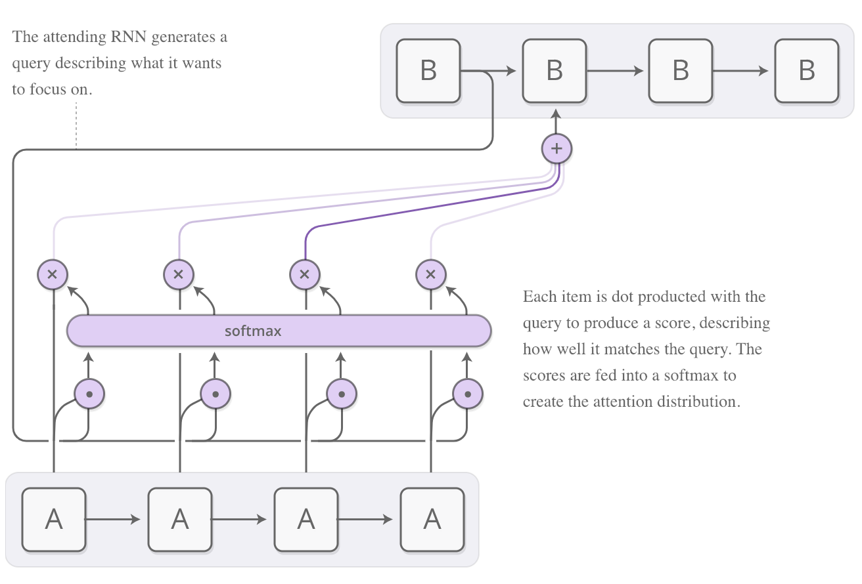
Seq2Seq + Attention
Chis Olah & Shan Cate, “Attention and Augmented Recurrent Neural Networks” distill.pub 2016.

Slide 39
Outline
Motivation
Seq2Seq
Key, Query and Value
Seq2Seq + Attention
Attention mechanisms
Study case: Image captioning

Slide 40
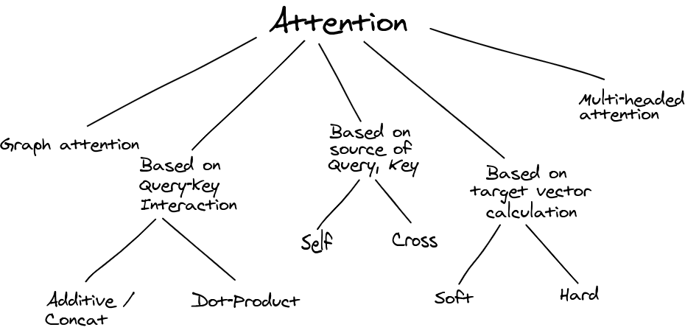
Attention Mechanisms
Nikhil Sha, “Attention ? An other Perspective!”. 2020.

Slide 41
Attention Mechanisms
How to compute these attention scores ?
Additive attention
Multiplicative
Scaled dot product
Slide concept: Abigail See, Matthew Lamm (Stanford CS224N), 2020

Slide 42
Outline
Motivation
Seq2Seq
Key, Query and Value
Seq2Seq + Attention
Attention mechanisms
Additive

Slide 43

Attention Mechanisms: Additive Attention
The first attention mechanism used a one-hidden layer feed-forward network to calculate the attention alignment:
concatenation
a(k,q) = w₂^{T} tanh(W₁ [k;q])
Key (K) / Values (V)
Query (Q)
Bahdanau, Dzmitry, Kyunghyun Cho, and Yoshua Bengio. "Neural machine translation by jointly learning to align and translate." ICLR 2015.

Slide 44
Attention Mechanisms: Additive Attention
The “additive” adjective corresponds to considering the MLP as two different ones, one focus on the query, another on the keys.
concatenation
addition
a(q,k) = w₂^{T} tanh(W₁ [q;k])
a(q,k) = w₂^{T} tanh(W_{q} q + W_{k} k)
Bahdanau, Dzmitry, Kyunghyun Cho, and Yoshua Bengio. "Neural machine translation by jointly learning to align and translate." ICLR 2015.

Slide 45
Outline
Motivation
Seq2Seq
Key, Query and Value
Seq2Seq + Attention
Attention mechanisms
Multiplicative

Slide 46
Attention Mechanisms: Multiplicative Attention
By discarding the tanh layer, keys and query can be directly compared with a multiplication depending on the learnable weights W_{q} and W_{k}.
a(q,k) = (q W_{q} )^{T} W_{k} k
=
Luong, M.-T., Pham, H., & Manning, C. D. (2015). Effective Approaches to Attention-based Neural Machine Translation. EMNLP 2015

Slide 47
Attention Mechanisms: Dot Product
If considering the projected query and keys, the multiplicative attention can be understood as a simple dot product.
a(q,k) = q^{T} k
=
Luong, M.-T., Pham, H., & Manning, C. D. Effective Approaches to Attention-based Neural Machine Translation. EMNLP 2015

Slide 48
Outline
Motivation
Seq2Seq
Key, Query and Value
Seq2Seq + Attention
Attention mechanisms
Scaled dot product

Slide 49
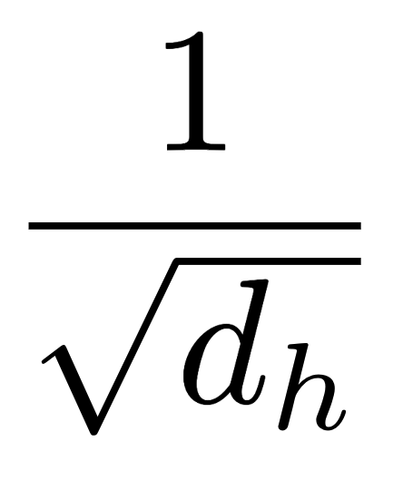
Attention Mechanisms: Scaled dot product
Multiplicative attention performs worse than additive attention for large dimensionality of the decoder state (d_{h}), unless a scaling factor is added:
a(q,k) = q^{T} k / √ d_{h}
=
#Transformer Vaswani, A., Shazeer, N., Parmar, N., Uszkoreit, J., Jones, L., Gomez, A. N., ... & Polosukhin, I.. Attention is all you need. NeurIPS 2017.

Slide 50
Attention Mechanisms: Scaled dot product
Considering a dot-product attention, how are the attention scores (a_{ij}) between each pair of input tokens x_{i} and x_{j} computed ?
Query (Q)
g(x) = W^{Q} x
Key (K)
f(x) = W^{K} x
Value (V)
h(x) = W^{V} x
W^{Q}, W^{K} and W^{V} are projection layers shared across all words.
a_{ij} = f(x_{i})^{T} · g(x_{j})
a_{ij} = f(x_{i})^{T} · g(y_{j})
a_{ij} = softmax[ f(x_{i})^{T} · g(x_{j}) ]
a_{ij} = softmax[ f(x_{i})^{T} · g(y_{j}) ]

Slide 51
Attention Mechanisms: Scaled dot product
Considering a dot-product attention, how are the attention scores (a_{ij}) between each pair of input tokens x_{i} and x_{j} computed ?
Query (Q)
g(x) = W^{Q} x
Key (K)
f(x) = W^{K} x
Value (V)
h(x) = W^{V} x
W^{Q}, W^{K} and W^{V} are projection layers shared across all words.
a_{ij} = f(x_{i})^{T} · g(x_{j})
a_{ij} = f(x_{i})^{T} · g(y_{j})
a_{ij} = softmax[ f(x_{i})^{T} · g(x_{j}) ]
a_{ij} = softmax[ f(x_{i})^{T} · g(y_{j}) ]

Slide 52
Outline
Motivation
Seq2Seq
Key, Query and Value
Seq2Seq + Attention
Attention mechanisms
Study case: Image captioning

Slide 53
Image Captioning without Attention
A
bird
flying
...
<EOS>
CNN
LSTM
LSTM
LSTM
...
LSTM
Features: D
Limitation: All output predictions are based on the final and static output of the encoder
Vinyals, O., Toshev, A., Bengio, S., & Erhan, D. (2015). Show and tell: A neural image caption generator. CVPR 2015.

Slide 54
Image Captioning with Attention
How can we encode an image as a set of representation to attend to ?
CNN
Image: H x W x 3
L=9 pixel embeddings

Slide 55
Attention for Image Captioning
L=9 x Attention weights
Predicted word
a1
y1
L=9 x
pixel embeddings
CNN
h0
Image: H x W x 3
c0
y0
The first context vector is the average of the L embeddings
First word (<start> token)
Slide: Amaia Salvador

Slide 56
Attention for Image Captioning
a1
y1
a2
y2
CNN
h0
h1
Image: H x W x 3
c0
y0
c1
y1
Visual features weighted with attention give the next context
Predicted word in previous timestep
Slide: Amaia Salvador

Slide 57
Attention for Image Captioning
a1
y1
a2
y2
a3
y3
CNN
h0
h1
h2
Image: H x W x 3
c0
y0
c1
y1
c2
y2
Slide: Amaia Salvador

Slide 58
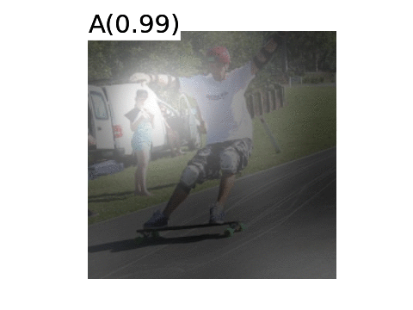
Attention for Image Captioning
Xu, Kelvin, Jimmy Ba, Ryan Kiros, Kyunghyun Cho, Aaron C. Courville, Ruslan Salakhutdinov, Richard S. Zemel, and Yoshua Bengio. "Show, Attend and Tell: Neural Image Caption Generation with Visual Attention." ICML 2015

Slide 59
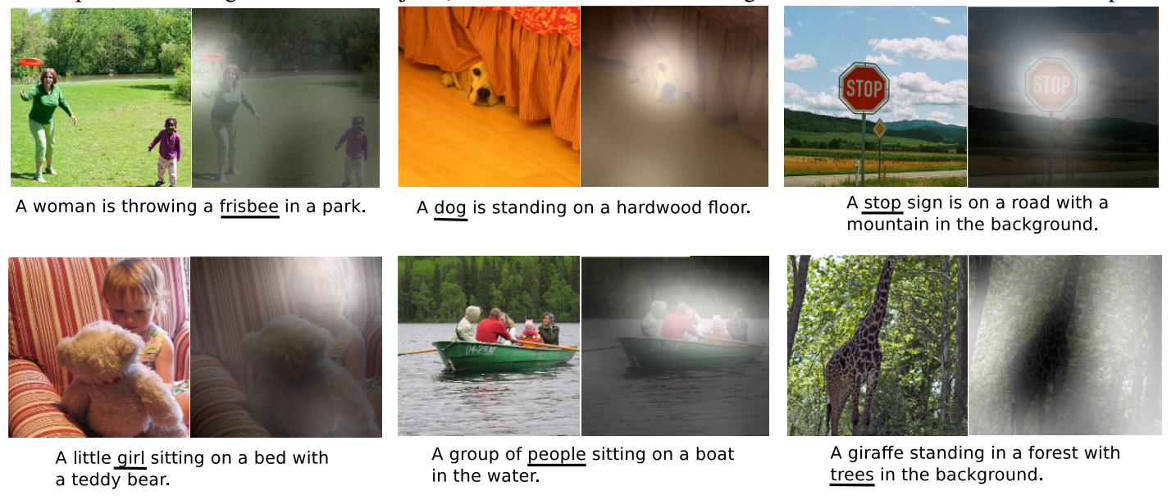
Attention for Image Captioning
Xu, Kelvin, Jimmy Ba, Ryan Kiros, Kyunghyun Cho, Aaron C. Courville, Ruslan Salakhutdinov, Richard S. Zemel, and Yoshua Bengio. "Show, Attend and Tell: Neural Image Caption Generation with Visual Attention." ICML 2015

Slide 60
Attention for Image Captioning
Side-note: attention can be computed with previous or current hidden state
y1
y2
y3
c1
c2
c3
a1
a2
a3
CNN
h1
h2
h3
Image: H x W x 3
average
v
y0
v
y1
v
y2

Slide 61
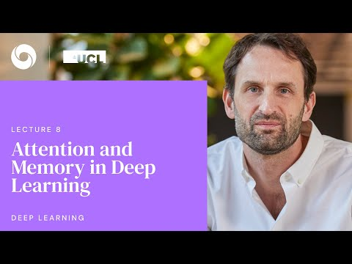
Learn more
Alex Graves, UCL x Deepmind 2020 [slides]

Slide 62
Learn more
Tutorials
Sebastian Ruder, Deep Learning for NLP Best Practices # Attention (2017).
Chris Olah, Shan Carter, “Attention and Augmented Recurrent Neural Networks”. Distill 2016.
Lilian Weng, “Attention? Attention!”. Lil’Log 2017.
Demos
François Fleuret (EPFL)

Slide 63
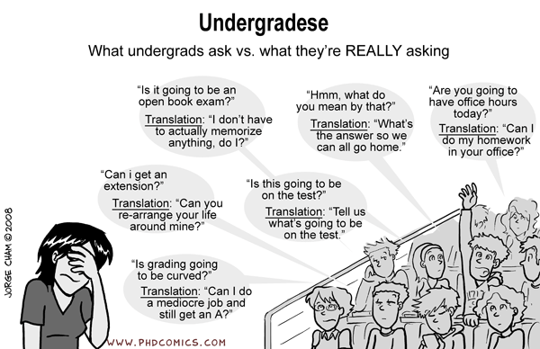
Questions ?

